Slide 2
Priority Queue
Is an Abstract Data Type.
Storing collection of prioritized elements.
Supports
arbitrary element insertion where position is specified by priority
(highest or lowest key).
removal of elements in order of priority
Each entry is a pair (key, value).
Key: used to identify or weigh that element.
Two distinct entries in a priority queue can have the same key.
Note 1: a priority queue is no longer FIFO!
Note 2: You will still remove from front of queue, but insertions are governed by a priority.

Slide 3
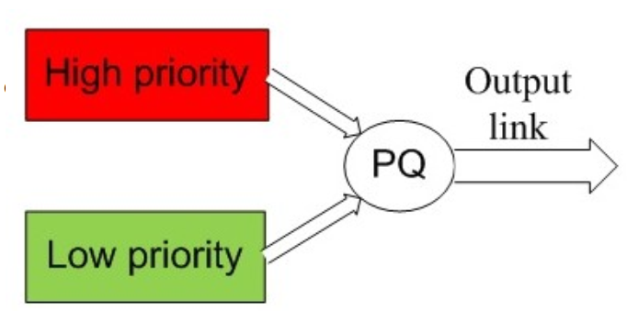
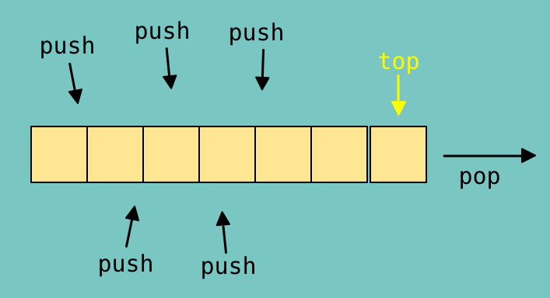

Slide 4
Operations
Basic operations
En(ter)queue(v, p) − Insert an entry with priority p and value v.
En(ter)queue(v) − Insert an entry with value v if value itself defines its priority.
De(lete)queue() − Remove and return the entry with highest priority key.
Supportive Operations
peek() − Return (do not remove) an entry with highest priority key.
isfull() − Checks if the queue is full.
isempty() − Checks if the queue is empty.
size() - Return the number of entries in the queue.
decreasePriority(v, p) - decrease the priority of value v to new priority p

Slide 5
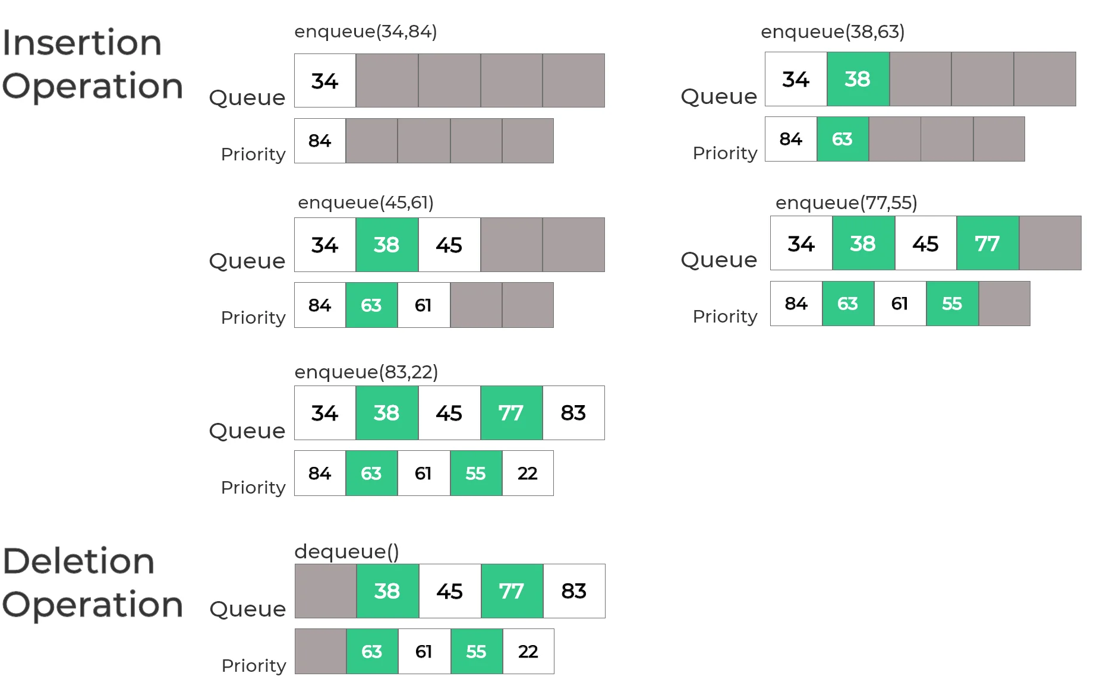

Slide 6
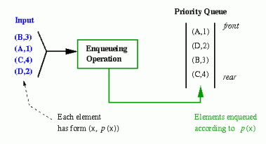

Slide 7
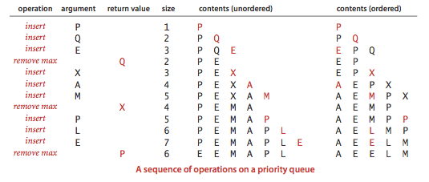

Slide 8
Insertion Sort
Insertion sort is the sort that results when we perform a PriorityQueueSort implementing the priority queue with a sorted sequence

